Slide 1
Day 08
Linux Device Driver Training
SORTING ALGORITHMS
Presented by,
Ganavi M
Ganavigowda512@gmail.com

Slide 2
INSERTION SORT
Insertion sort is a simple sorting algorithm that works by iteratively inserting each element of an unsorted list into its correct position in a sorted portion of the list. It is a stable sorting algorithm, meaning that elements with equal values maintain their relative order in the sorted output.
Algorithm:
Divide the array into two sub-arrays: sorted and unsorted.
Iterate through the unsorted sub-array, taking one element at a time and inserting it into its correct position in the sorted sub-array.
Repeat this process until the entire array is sorted.
Explanation:
Insertion Sort builds the final sorted array one item at a time by repeatedly taking the next item from the unsorted part and inserting it into its correct position in the sorted part. It is similar to sorting a hand of playing cards by repeatedly picking one card from the unsorted part and inserting it into the correct position among the sorted cards.

Slide 3

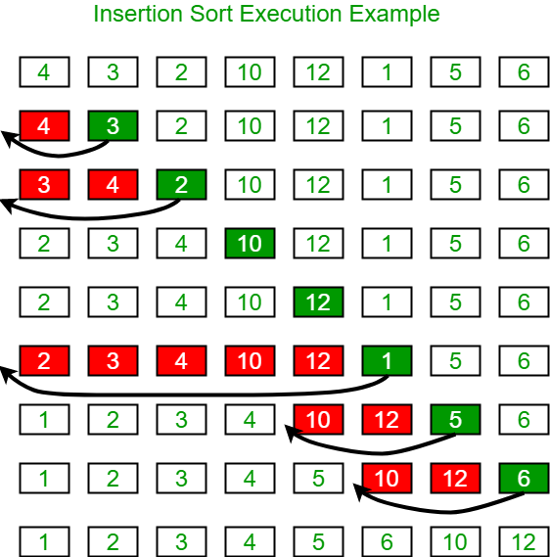

Slide 4
Advantages of Insertion Sort:
Simple and easy to implement.
Stable sorting algorithm.
Efficient for small lists and nearly sorted lists.
Space-efficient.
Disadvantages of Insertion Sort:
Inefficient for large lists.
Not as efficient as other sorting algorithms (e.g., merge sort, quick sort) for most cases.
Applications of Insertion Sort:
Insertion sort is commonly used in situations where:
The list is small or nearly sorted.
Simplicity and stability are important.

Slide 5
BUBBLE SORT
Definition:
Bubble Sort is a simple sorting algorithm that repeatedly steps through the list, compares adjacent elements, and swaps them if they are in the wrong order.
Algorithm:
Compare each pair of adjacent elements and swap them if they are in the wrong order.
Repeat this process until the entire array is sorted.
Explanation:
Bubble Sort works by repeatedly stepping through the list of items to be sorted, comparing each pair of adjacent items and swapping them if they are in the wrong order. This process continues until the entire array is sorted. It gets its name because smaller elements gradually "bubble" to the top of the array with each pass.

Slide 6
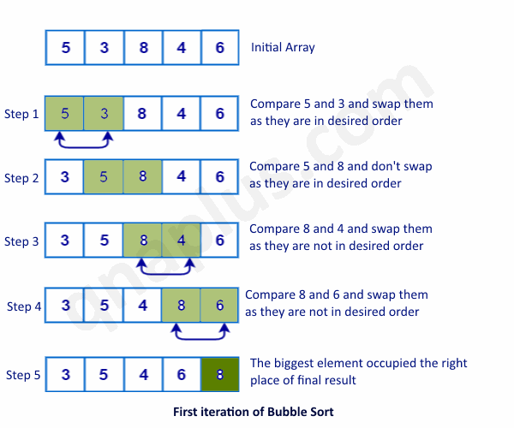

Slide 7
Example:
Pass 1: [5, 2, 8, 3, 1] -> [2, 5, 3, 1, 8]
Pass 2: [2, 5, 3, 1, 8] -> [2, 3, 1, 5, 8]
Pass 3: [2, 3, 1, 5, 8] -> [2, 1, 3, 5, 8]
Pass 4: [2, 1, 3, 5, 8] -> [1, 2, 3, 5, 8]
Advantages:
Simple implementation.
Suitable for small datasets or nearly sorted arrays.
Disadvantages:
Inefficient for large datasets (quadratic time complexity).
Not suitable for large-scale or performance-critical applications.
Applications:
Used for educational purposes.
Suitable for sorting small datasets with simplicity as a priority.

Slide 8
MERGE SORT
Definition:
Merge Sort is a divide-and-conquer algorithm that divides the input array into two halves, recursively sorts each half, and then merges the sorted halves to produce the final sorted array.
Algorithm:
Divide the array into two halves recursively until each sub-array contains only one element.
Merge the sub-arrays in a sorted manner by comparing elements from each sub-array and merging them into a single sorted array.
Explanation:
Merge Sort divides the array into smaller sub-arrays, sorts each sub-array, and then merges them back together in a sorted manner. It uses a "divide and conquer" strategy to sort the array efficiently.

Slide 9
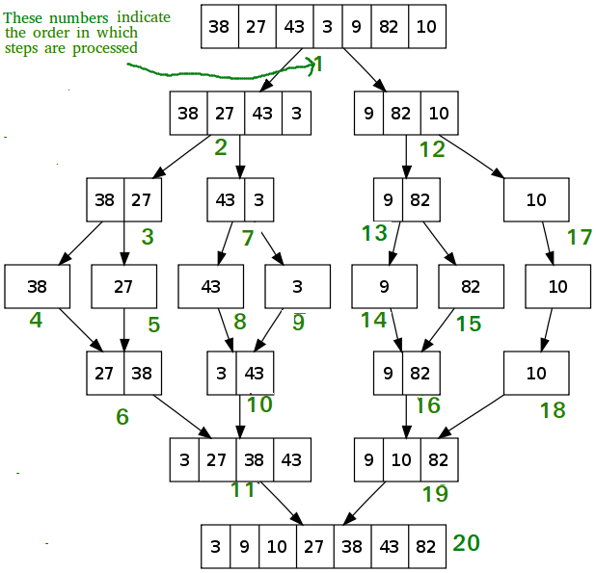

Slide 10
Example:
Pass 1: [5, 2, 8, 3, 1] -> [2, 5], [1, 3, 8]
Pass 2: [2, 5], [1, 3, 8] -> [1, 2, 3, 5, 8]
Advantages:
Stable sorting algorithm with optimal time complexity (O(n log n)).
Efficient for large datasets.
Disadvantages:
Requires additional memory for the merging process.
Applications:
Widely used in practice, especially for sorting large datasets or when stability is required.

Slide 11
QUICK SORT
Definition:
Quick Sort is a divide-and-conquer algorithm that selects a pivot element and partitions the array into two sub-arrays such that elements less than the pivot are on the left and elements greater than the pivot are on the right.
Algorithm:
Choose a pivot element from the array.
Partition the array into two sub-arrays: elements less than the pivot and elements greater than the pivot.
Recursively apply Quick Sort to each sub-array.
Explanation:
Quick Sort selects a pivot element and partitions the array into two sub-arrays such that elements less than the pivot are on the left and elements greater than the pivot are on the right.

Slide 12
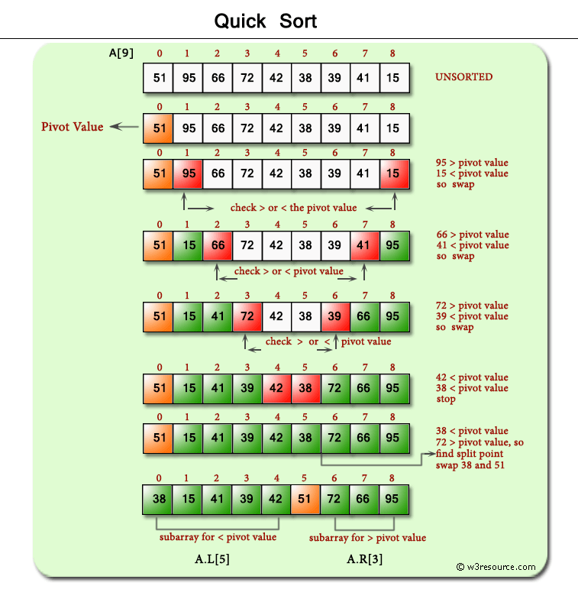

Slide 13
Example:
Pass 1: [5, 2, 8, 3, 1] -> [2, 1], [3], [5, 8]
Pass 2: [2, 1], [3], [5, 8] -> [1], [2], [3], [5, 8]
Pass 3: [1], [2], [3], [5, 8] -> [1], [2], [3], [5], [8]
Advantages:
Efficient for large datasets on average (time complexity: O(n log n)).
Disadvantages:
Can degrade to O(n^2) in the worst case if the pivot is consistently poorly chosen.
Applications:
Widely used in practice due to its average-case efficiency.
Suitable for sorting large datasets and real-time applications.

Slide 14
HEAP SORT
Definition:
Heap Sort is a comparison-based sorting algorithm that organizes numbers into a binary heap, then repeatedly extracts the maximum element to sort the array.
Algorithm:
Build a max heap from the array.
Extract the maximum element (root) repeatedly and adjust the heap.
Explanation:
Heap Sort organizes numbers into a max heap where each parent is greater than or equal to its children, then repeatedly extracts the maximum element to sort the array.

Slide 15
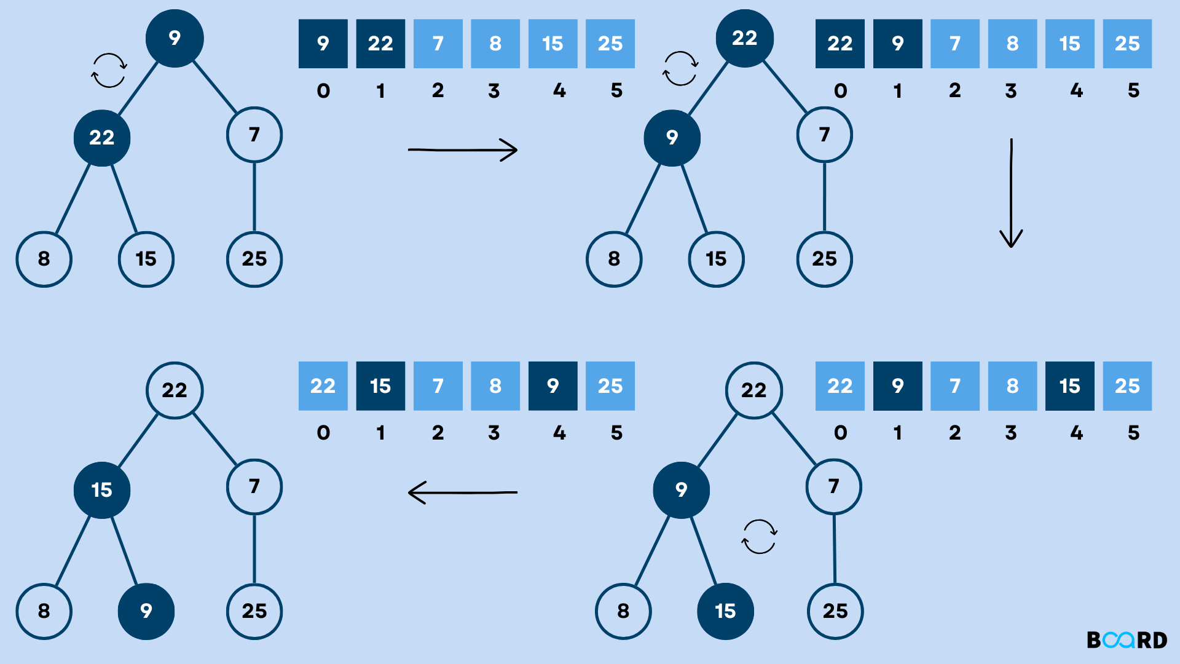

Slide 16
Example:
Pass 1: [5, 2, 8, 3, 1] -> [1, 2, 8, 3, 5]
Pass 2: [1, 2, 8, 3, 5] -> [2, 3, 8, 5], [1]
Pass 3: [2, 3, 8, 5], [1] -> [3, 5, 8], [1, 2]
Pass 4: [3, 5, 8], [1, 2] -> [5, 8], [1, 2, 3]
Advantages:
Efficient for large datasets (time complexity: O(n log n)).
In-place sorting algorithm (space complexity: O(1)).
Disadvantages:
Less intuitive compared to other sorting algorithms.
Applications:
Used in priority queues, where elements with higher priorities are processed first.

Slide 17
COMPARISON
Algorithm Complexity:
Bubble Sort and Insertion Sort have quadratic time complexity, making them inefficient for large datasets.
Merge Sort, Quick Sort, and Heap Sort have average-case time complexity of O(n log n), making them suitable for large datasets.
Stability:
Merge Sort is stable, meaning it preserves the relative order of equal elements.
Bubble Sort and Insertion Sort are also stable.
Quick Sort and Heap Sort are not inherently stable but can be implemented to maintain stability.
Space Complexity:
Bubble Sort, Insertion Sort, and Heap Sort have constant space complexity (O(1)) as they sort in-place.
Merge Sort requires additional space for merging, resulting in O(n) space complexity.

Slide 18
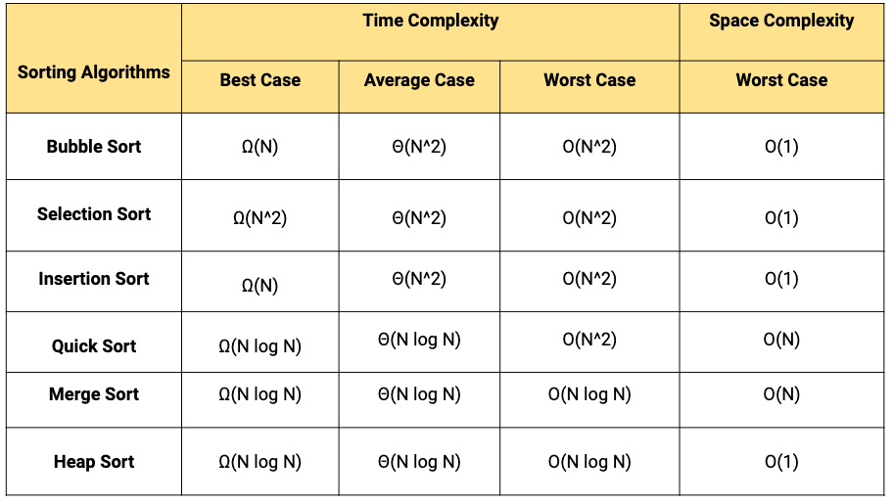

Slide 19
RECURSION
Definition:
Recursion is a programming technique where a function calls itself directly or indirectly to solve a problem.
Basic Concepts:
Base Case: A condition that terminates the recursive process.
Recursive Case: A step where the function calls itself with modified arguments to move towards the base case.
Example:
Factorial Calculation: factorial(n) = n * factorial(n-1)
Advantages:
Simplifies the implementation of complex algorithms.
Solves problems in a more natural and concise way.
Disadvantages:
Can lead to stack overflow if not implemented properly.
May have performance overhead due to multiple function calls.

Slide 20
BINARY TREES
Definition:
A binary tree is a hierarchical data structure where each node has at most two children: left and right.
Basic Concepts:
Root: The topmost node of the tree.
Parent, Child, Siblings: Nodes connected in hierarchical relationships.
Leaf Node: A node with no children.
Types:
Full Binary Tree: Every node has either 0 or 2 children.
Complete Binary Tree: All levels are completely filled except possibly for the last level, which is filled from left to right.
Binary Search Tree (BST): A binary tree where the left child of a node contains only nodes with keys less than the node's key, and the right child contains only nodes with keys greater than the node's key.
Operations:
Insertion: Adding a new node to the tree.
Deletion: Removing a node from the tree.
Traversal: Visiting all nodes in a specific order (inorder, preorder, postorder).
Applications:
Efficient searching, insertion, and deletion operations in databases and filesystems.
Representing hierarchical data structures like expression trees and syntax trees.

Slide 21
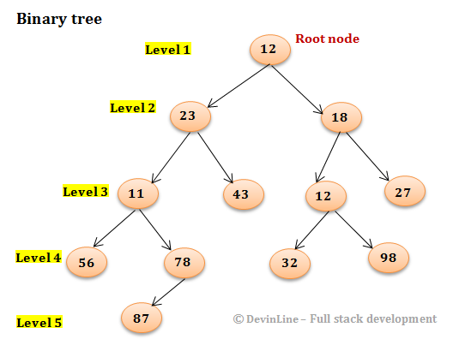

Slide 22
Thank you

